Slide 1
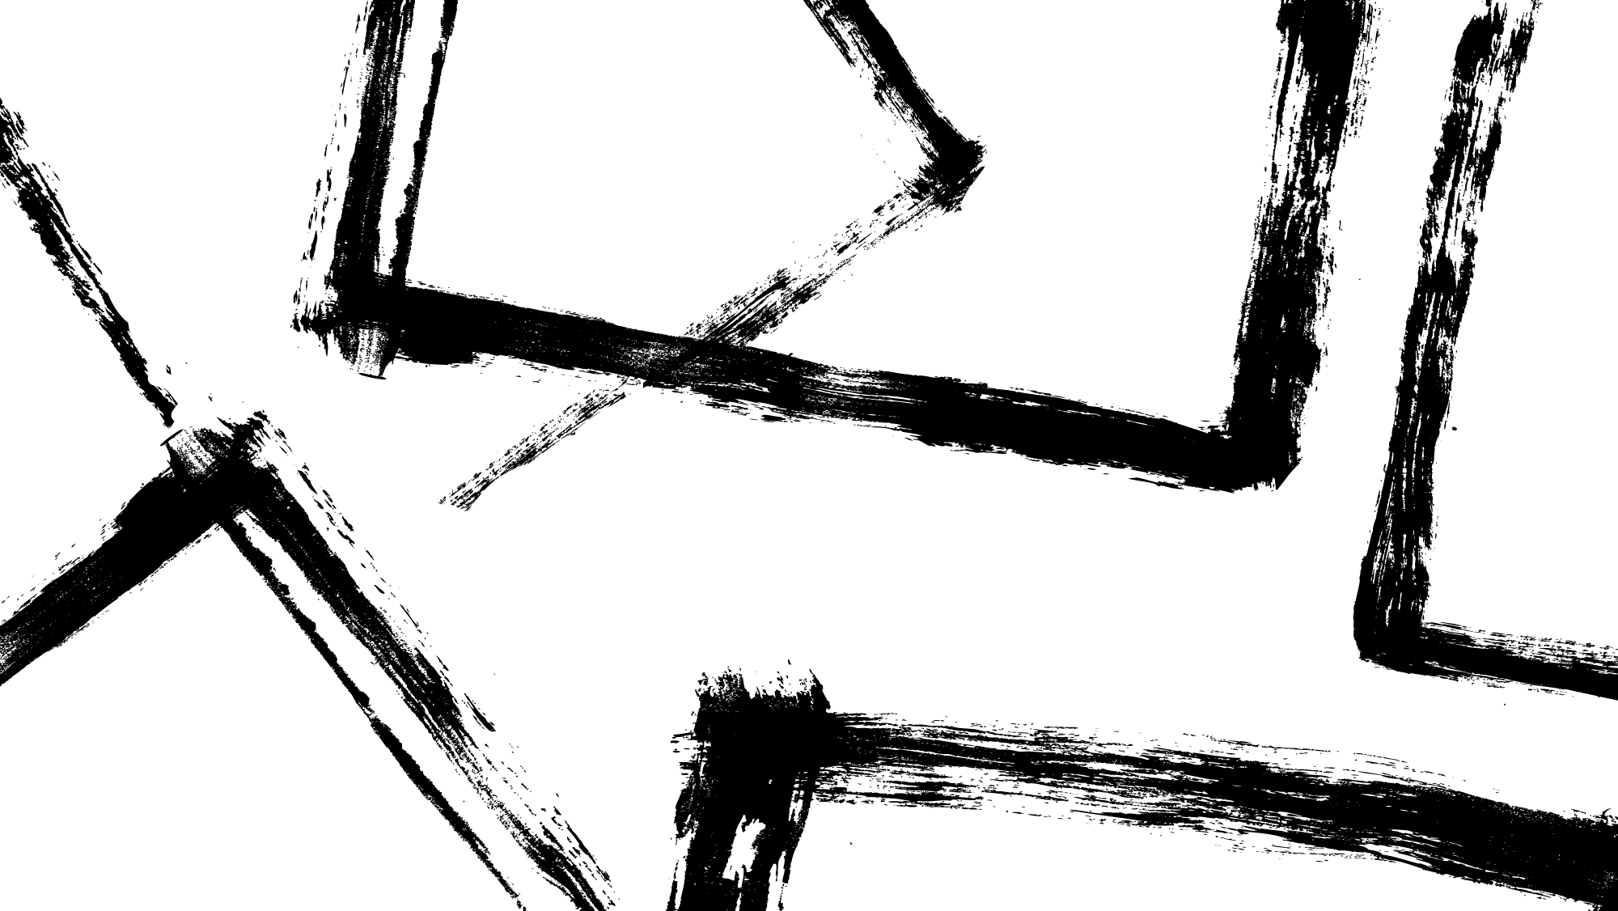
Developing and studying instruction-following models
Tatsunori Hashimoto, Stanford CS
Future of Decentralization, AI, and Computing Summit
Notes:
Thank you all for coming, and for the invitation to speak. I’m excited to talk to you about some of the work we’ve done around instruction-following models, both building tooling for them and also improving them. (15s)

Slide 2
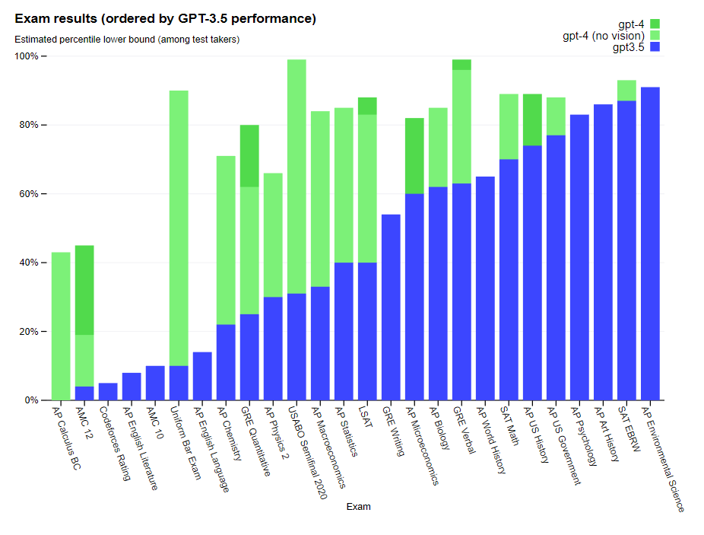
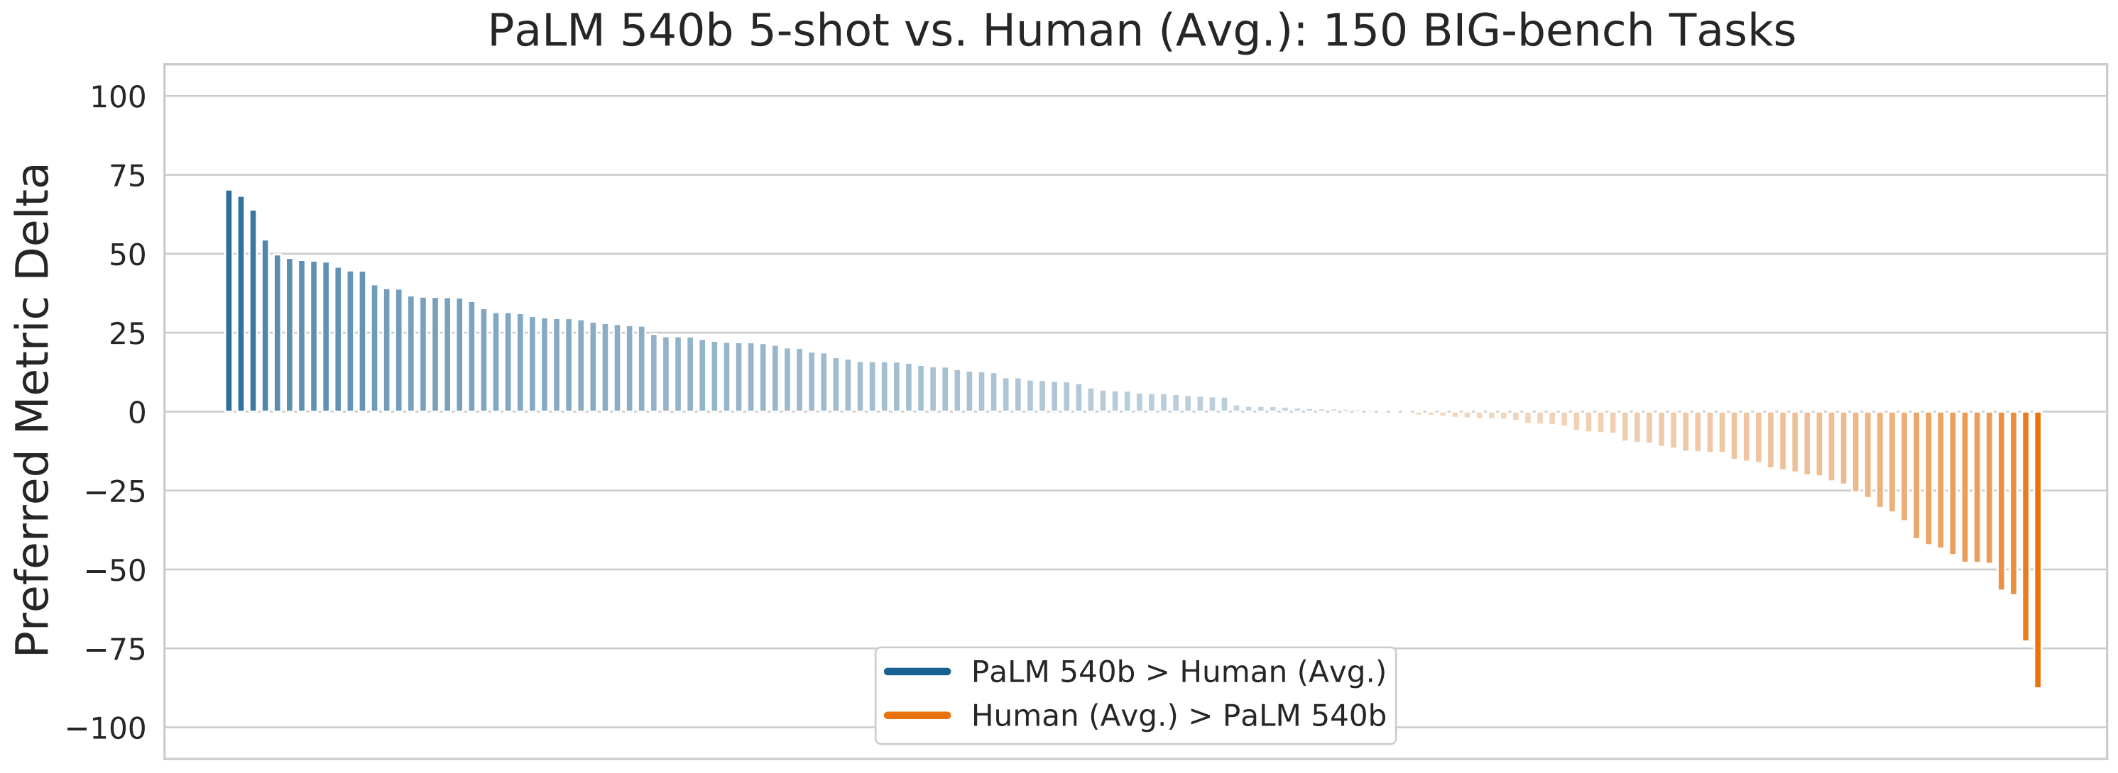
LLMs in the spotlight
Google PaLM on BigBench
GPT4 on a range of exams
Impressive, ongoing advances in NLP and AI from large language models!
Notes:
Large language models are having a moment – with google’s PaLM models achieving remarkably good performance on challenging benchmarks such as bigBench, and OpenAI’s gpt4 achieving remarkably good performance on a number of professional exams (15s)

Slide 3
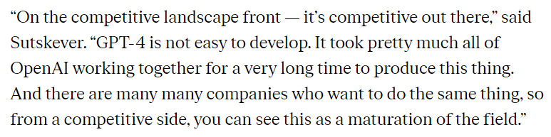
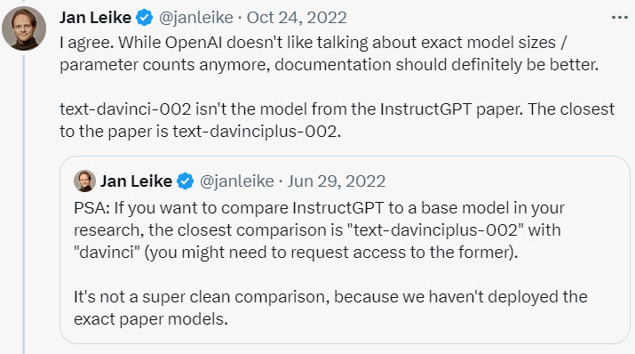
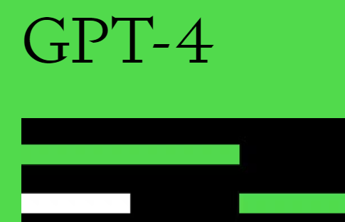
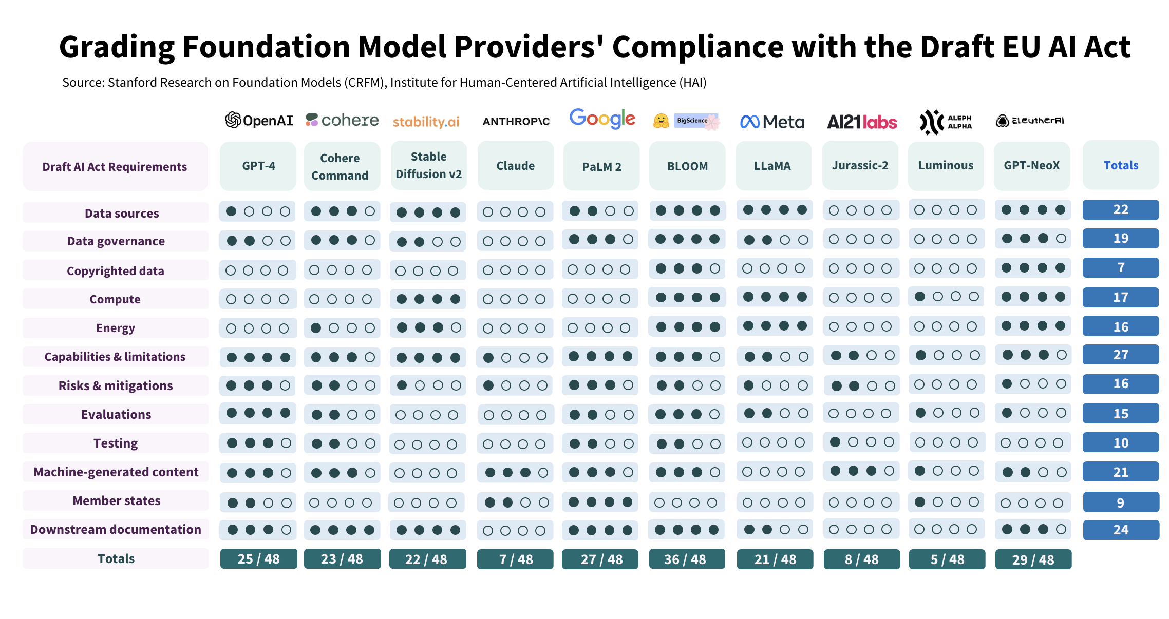
These models are increasingly closed off
Notes:
But while these advances are impressive, much of these advances are happening increasingly behind closed doors. On the top left is a quote from around the GPT-4 release, where OpenAI elected not to release any details about their systems, with a large part of that decision being driven by competitive pressures.
On the top right is the twitter message where many of us in the research community learned that the text-davinci-002 model is not related to the instructGPT paper at all, and the closest comparable model was a model not available to the public called text-davinciplus-002.
I’ve picked out two examples from OpenAI because they’ve been at the center of the conversation, but they’re not an outlier in the landscape of proprietary LMs, as shown by this chart on the bottom produced by colleagues at Stanford evaluating different vendors for compliance with EU’s AI transparency regulations. Indeed, other vendors like cohere, anthropic, ai21, and aleph alpha are all similar. (53)

Slide 4
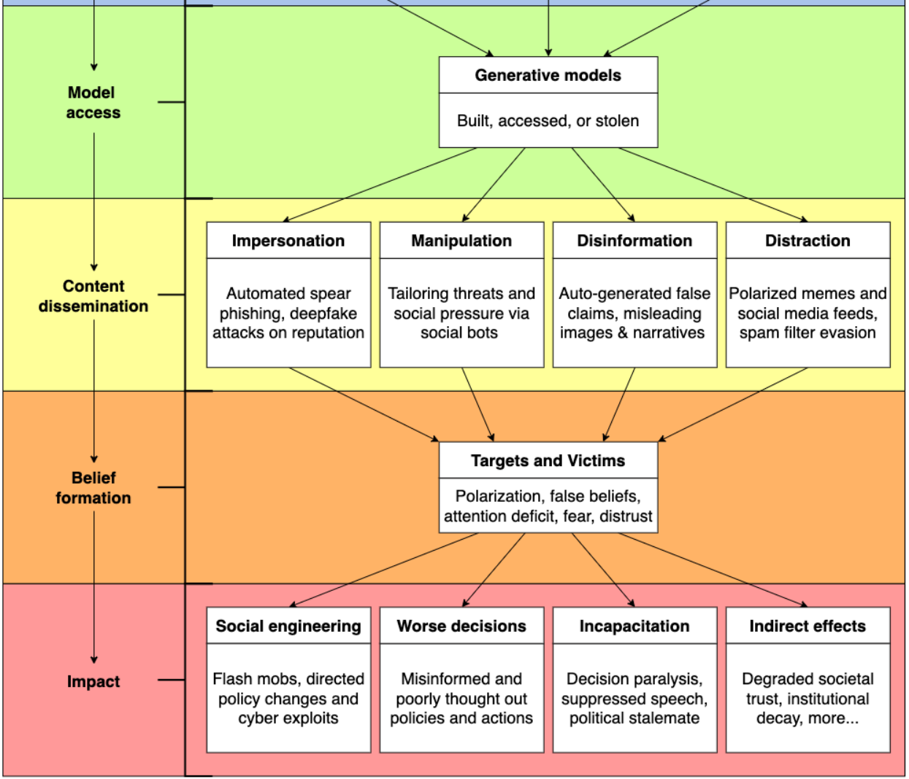
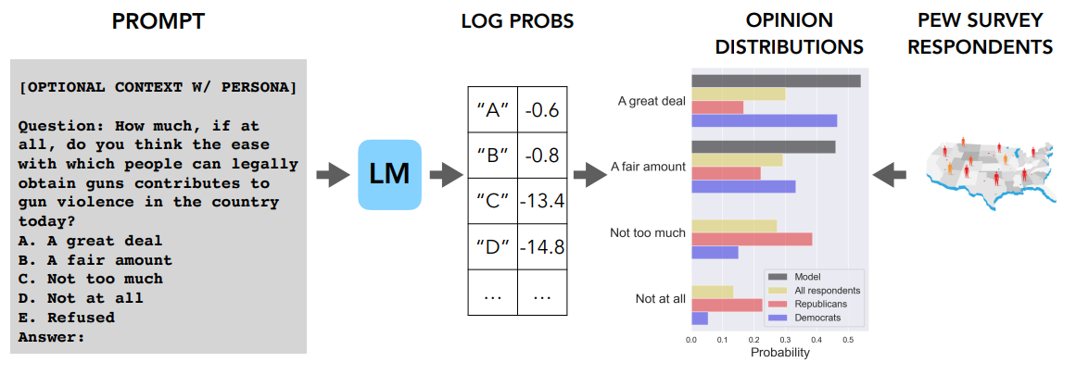
Closed models are hard to study and improve
Dual-use / misuse [Kang 2023]
Political values / biases [Santurkar 2023]
API-only access makes it difficult to do deep analysis or propose improvements
Notes:
This is increasingly going to be a problem – API only access limits our ability to understand and improve these models, and this is not even beginning to get at the issues associated with LLM vendors potentially changing and deprecating models.
As examples, some of the work in my group has studied aspects of trustworthiness, like LLM’s ability to refuse dual use instructions, or the types of political values that LLMs reflect from their training data. However, the API only access makes it hard to study interventions – can we watermark the text, or improve RLHF to better combat LLM based spammers? Can we fine-tune models to be more steerable or adopt neutral points of view?
Even worse, many of the key scientific ingredients like reinforcement learning from human feedback (or RLHF) have not been studied much at all outside of the LLM vendors, making discussions regarding existing interventions mostly hearsay and folklore. (51)

Slide 5
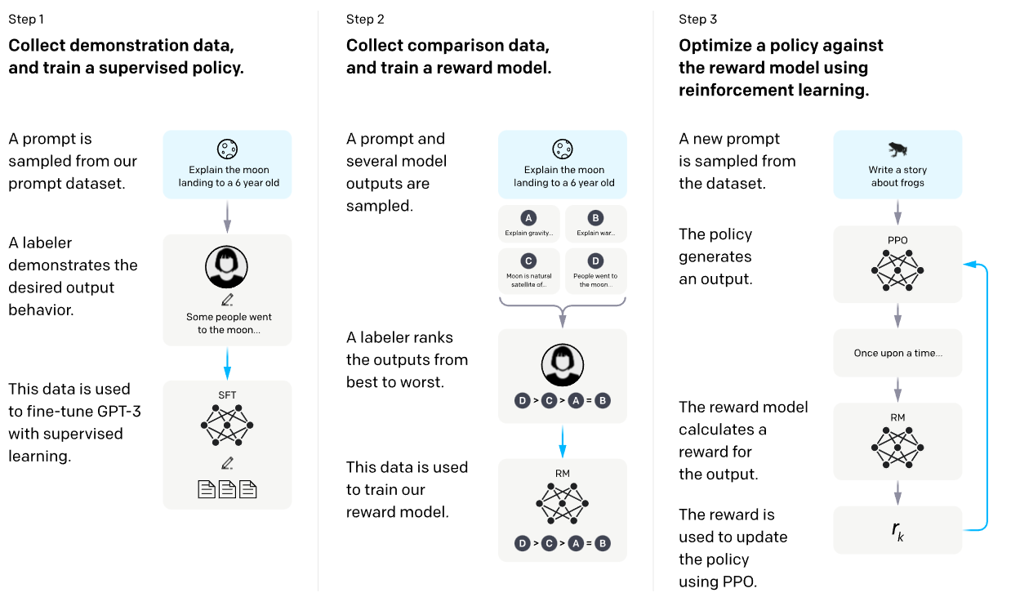
Reproducible low-cost environments for LLM experiments
Reproducing instruction-following models
Cost : high cost of human annotation
Replicability : crowdsourcing doesn’t replicate
Reference : no known working PPO implementation
[Ouyang 2020]
What’s the impact of instruction tuning?
Does reinforcement learning actually help?
What changes does RL actually make?
Why is this hard? Figuring this out (in full) requires replicating instructGPT/chatGPT
Notes:
Because of this, we set out to try to build low-cost experimental environments for studying LLMs past the pre-training phase.
Our goal here isn’t going to be to replicate or replace ChatGPT, but to substantially lower the cost of prototyping and developing new LLM tuning algorithms.
In particular, we focused on a few major issues. The first two are the cost and replicability challenges associated with crowdsourced annotation in supervised fine-tuning and reinforcement learning. Machine learning, as a field, has advanced on the back of replicable and standardized benchmarks and datasets, and so we set out to build something comparable for RLHF.
The other major issue we found was the lack of a validated and working implementation of RLHF baselines – the works before us had evaluated on extremely simple tasks like summarization that turned out not to transfer much at all to open ended instruction following.
Building this environment was going to be key to answering many of our most pressing questions – like the impact of instruction tuning vs reinforcement learning, and the types of changes that RLHF makes on a model. (60)

Slide 6
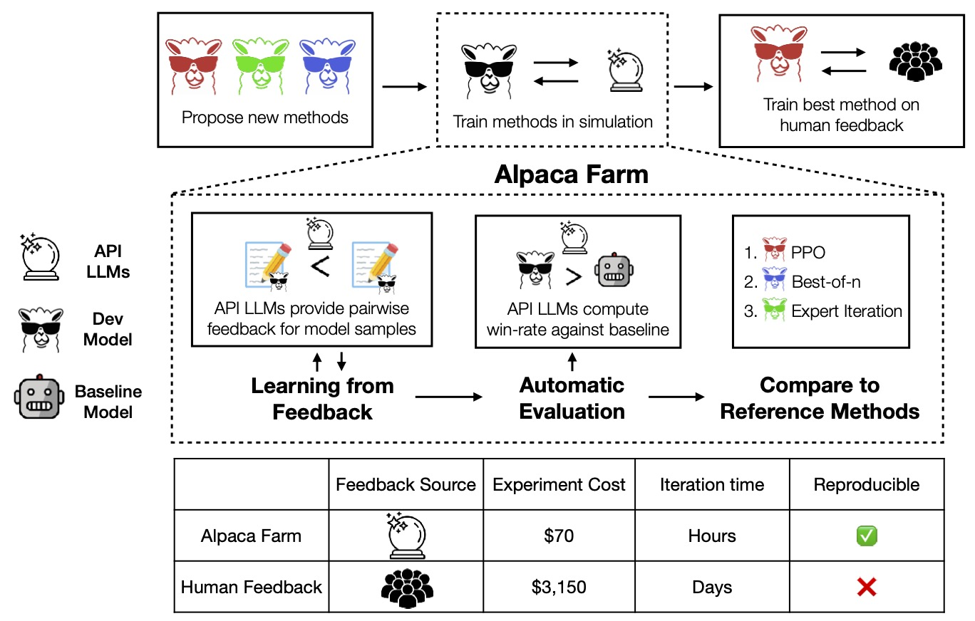
Alpaca trio: low-cost experiments for instruction-following
Step 1 (SFT) – Alpaca
Step 2 (RLHF) – AlpacaFarm
Step 3 (Evals) - AlpacaEval
Simulating annotators (via GPT4) enables fast, low-cost prototyping and R&D of LLMs
[Dubois, Li, Taori, Zhang et al 2023]
Notes:
To make this happen, over the past few months we developed three linked projects – Alpaca, which is a simple baseline for supervised finetuning, AlpacaFarm, which is shown on this slide, which is a simulator for the full RLHF pipeline that reduces the cost and time of doing alignment research, and AlpacaEval, which is a low-cost automatic evaluator that is useful for guiding model development and hyperparameter tuning.
All of these components leverage an idea that’s become fairly standard now – using GPT4 as a simulated annotator in place of a crowdworker.
Together, these systems provide tooling to make R&D for large language models much cheaper and easier. We’ll talk about one example of how we’ve used some of these components to do research, but first I want to talk about the AlpacaFarm simulator. (45)

Slide 7
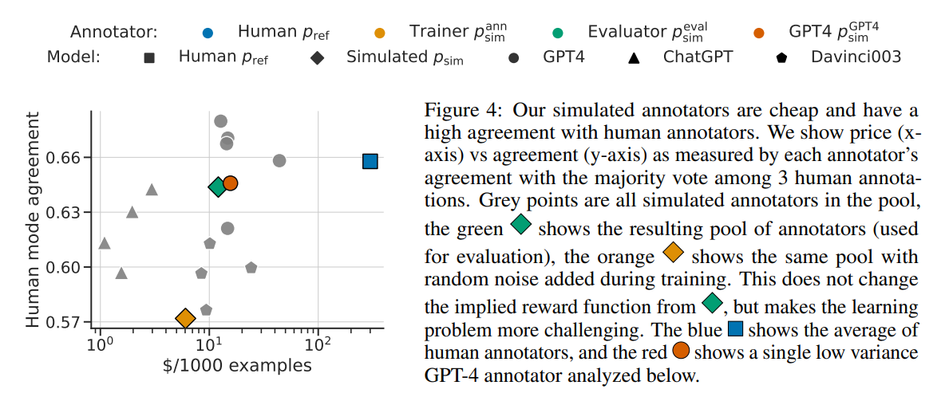
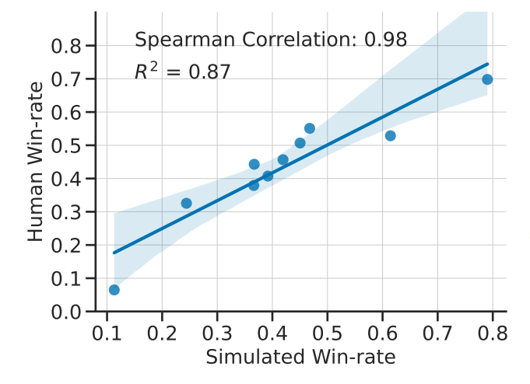
Validating the accuracy of simulated annotations
Agreement near human inter-annotator levels
Near-perfect rank correlation at the system level
[Dubois, Li, Taori, Zhang et al 2023]
Notes:
The first question you might ask is – is using GPT4 as a simulated annotator a reasonable thing to do? It turns out that it’s a reasonable proxy for our goals. First, we find that GPT4 agrees with human annotators about as often as humans – shown as the orange and blue dots respectively, while the GPT4 annotator is 20 times cheaper.
The real test though, is whether conclusions from these simulated annotators transfer to actual human evaluators, and the plot on the right shows that systems that are rated as being high-quality by AlpacaFarm have nearly exactly the same ranking under human annotators, where the x and y- axes here represent the win rate of a model against text-davinci-003. (35)

Slide 8
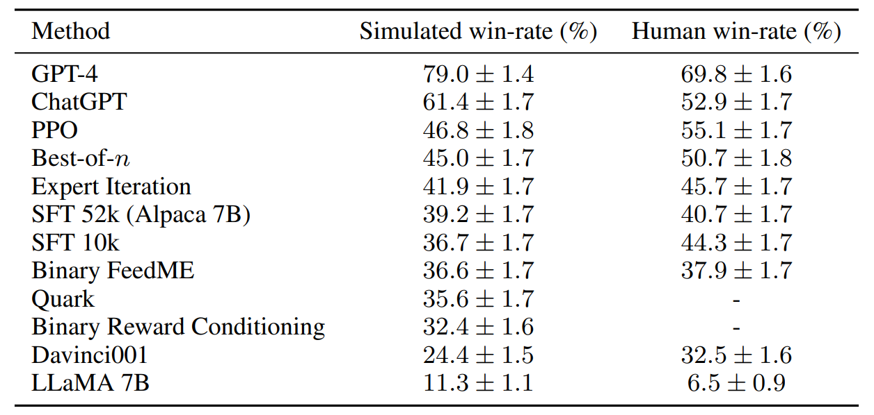
High-performance, reference methods for RLHF
Our findings replicate RLHF’s effectiveness, and these results hold outside the simulator
[Dubois, Li, Taori, Zhang et al 2023]
Notes:
We then re-implemented a large number of canonical RLHF algorithms, tuned and trained these models on the AlpacaFarm simulator. The numbers here are win-rates against text-davinci-003 on an instruction-tuning evaluation set we validated against real user interactions on the Alpaca Demo. These simulator results are some of the first replications of OpenAI’s instructGPT paper in an open setting, and show substantial gains via PPO.
But we went further than that, and re-did our entire experimental setup using humans, training these models on carefully selected crowdworkers from Amazon Mturk. We find nearly identical results, with PPO continuing to perform well, validating the simulator as well as our reference implementations. (36)

Slide 9
High-performance, reference methods for RLHF
Our findings replicate RLHF’s effectiveness, and these results hold outside the simulator
[Dubois, Li, Taori, Zhang et al 2023]
Notes:
We then re-implemented a large number of canonical RLHF algorithms, tuned and trained these models on the AlpacaFarm simulator. The numbers here are win-rates against text-davinci-003 on an instruction-tuning evaluation set we validated against real user interactions on the Alpaca Demo. These simulator results are some of the first replications of OpenAI’s instructGPT paper in an open setting, and show substantial gains via PPO.
But we went further than that, and re-did our entire experimental setup using humans, training these models on carefully selected crowdworkers from Amazon Mturk. We find nearly identical results, with PPO continuing to perform well, validating the simulator as well as our reference implementations. (36)

Slide 10
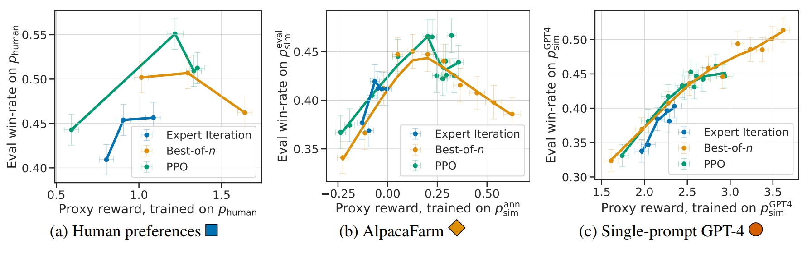
AlpacaFarm highlights the complexity of instruction RLHF
AlpacaFarm replicates important, complex phenomena like overoptimization
[Dubois, Li, Taori, Zhang et al 2023]
Notes:
As a final note, I want to highlight one very interesting aspect of AlpacaFarm is that we can replicate some of the complex failure modes of RLHF, like overoptimization – which is a phenomenon that’s been observed by OpenAI but not too in academia.
In this plot, we plot how well we’ve optimized the RLHF objective on the x-axis, and preferences on the y-axis. In both human and AlpacaFarm, we see a unimodal behavior, where RLHF helps up to a point, where performance starts to degrade. On the other hand, if we design the simulator naively by just picking a single good GPT 4 prompt, we see very different behaivor due to the preference feedback being too noise free and easy to learn. (41)

Slide 11
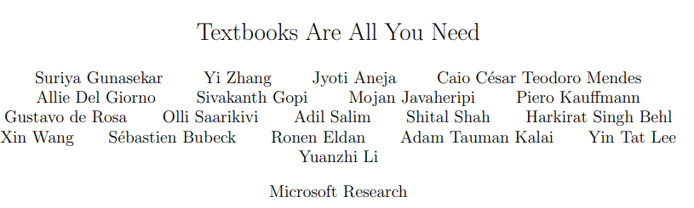
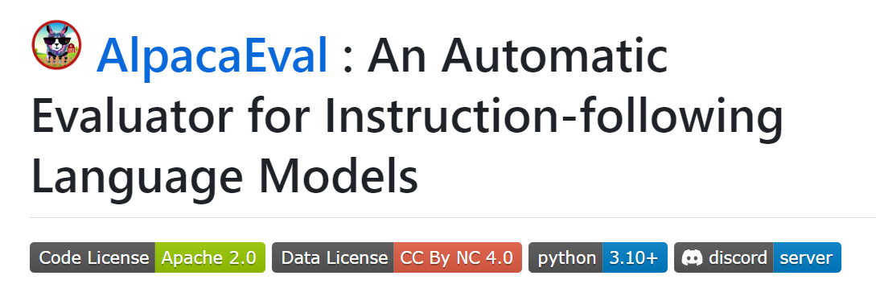
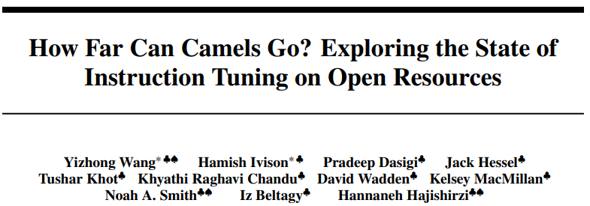
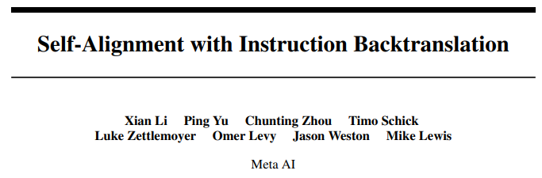
Beyond this work: LLM driven prototyping lowers the cost of R&D
Studying fine-tuning data
Development metrics
Caveat: development and deployment needs more than automated data/evals
Development metrics, synthetic data
Crowdsourced data + evaluation
Live evaluation
Notes:
Looking more broadly, there’s been a trend of leveraging LLMs to accelerate LLM research itself.
Some examples include the recent textbooks are all you need paper, using GPT4 to explore better types of pretraining data, such as ‘textbook like data’, and there’s a really nice meta-analysis by Yizhong and colleagues at UW that uses the large number of instruction tuning datasets people are creating to understand how instruction data affects downstream performance.
Complementing this is some work on automated eval, including some work by my students on creating faster automated evaluations for developing new models, and you can see these ideas accelerating research, with the recent instruction backtranslation work using this type of eval extensively to study ablations and scaling experiments.
I want to close this section up by highlighting that the goal here isn’t to replace or surpass high-quality human annotation – we have some of the earliest work highlighting the pitfalls of using LM based evaluation. Instead, the techniques here are useful in the prototyping and R&D phase, where human evaluation and annotation might be too slow or expensive. (60)

Slide 12
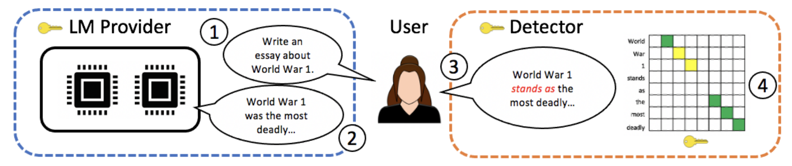
Case study: watermarking LLMs
Watermarking enables tracking of LLM-generated text (see Kirchenbauer et al)
Challenges:
Watermarks induce distortion (hard sell for LLM vendors)
Many watermarks highly non-robust (to deletion of a few words, or cropping)
Notes:
I want to end with one example of a recent work that relies on open models, and some of the instruction-tuning work that we’ve done.
Generative watermarking of text provides a powerful promise – the ability to not only identify LLM generated text, but also do so with provable guarantees of false positive rates. A truly robust, distortion-free watermark would be enormously impactful to combatting disinformation and misuse.
However, major challenges remain. Existing watermarks are easy to detect, but induce a strong distortion, and it’s not clear if these watermarks are particularly robust.
In recent work, some co-authors and I show that there are distortion-free, and robust watermarks. (35)

Slide 13
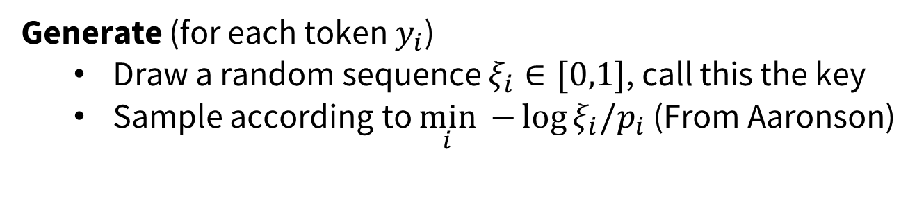
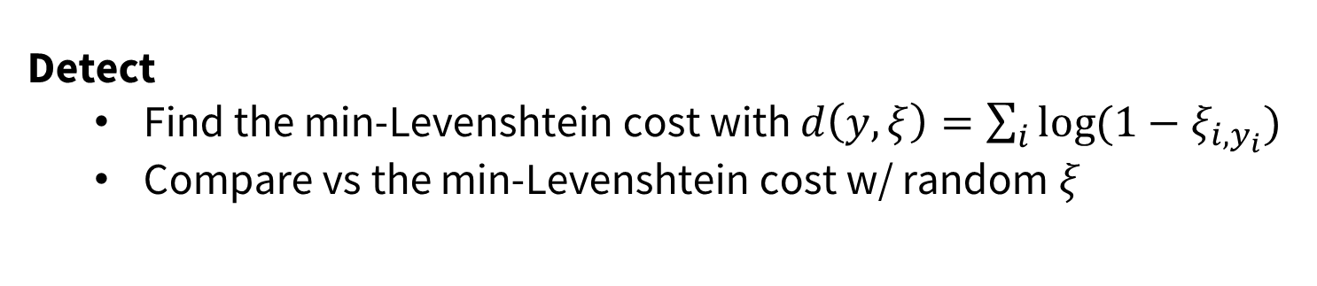
Development of a distortion-free, robust watermark.
In recent work [Kuditipudi et al 2023], we derive a distortion free and robust watermark.
Generate (for each token $y_{i}$)
Draw a random sequence $ξ_{i}∈[0,1]$, call this the key
Sample according to $\min_{i}{ −\log{ξ_{i}/p_{i}}}$ (From Aaronson)
This is distortion free (i.e. the marginal distribution over $ξ$ is p)
Detect
Find the min-Levenshtein cost with $d\left(y,ξ\right)=\sum_{i}{\log{(1−ξ_{i,y_{i}}) }}$
Compare vs the min-Levenshtein cost w/ random $ξ$
This is robust (i.e. can detect under small Levenshtein edits)
[Kuditipudi et al 2023]
Notes:
The conceptual idea is extremely simple – we draw a long, random sequence which we call the watermark key.
To generate a piece of text, we use an unpublished trick by Scott Aaronson where we take the log-ratio of the key and the language mode’s softmax, and return the minimum index.
With a bit of work, one can show that this is distortion free, in the sense that if we randomize over the key, we get exactly the original language model distribution.
To detect the watermark, we try to align the watermark key to the generated text sequence by minimizing the levenshtein distance defined by a particular distance metric. Comparing this against the levenshtein costs of random other keys allows us to generate a p-value with false positive rate guarantees., and this procedure is robust to any levenshtein distance distortion by construction. (48)

Slide 14
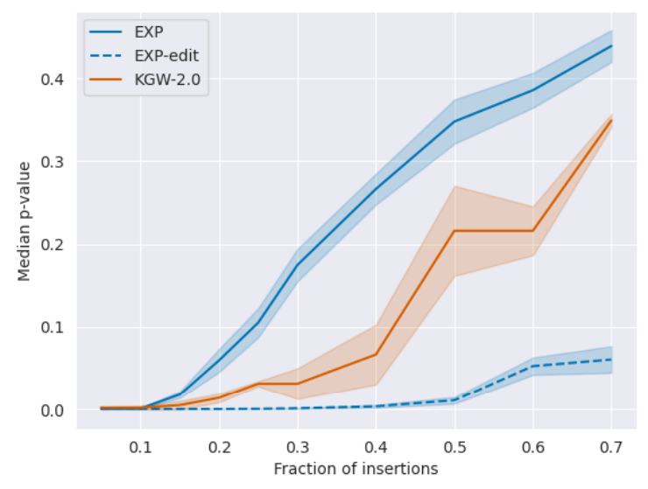
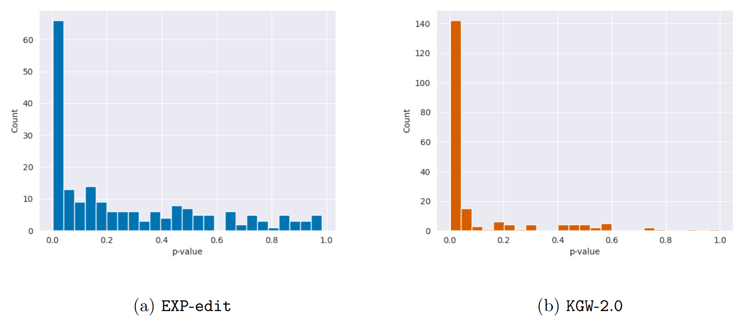
Watermarks and open models
Open models (and access to logprobs) enable watermarking research
Open instruction-tuning models and evals lead to new open problems
Distortion-free watermarks are weaker on instruction-tuned models
Distortion-inducing watermarks lead to major drops in performance
AlpacaEval Win Rate
70.86%
51.2%
Unwatermarked
KGW watermark
[Kuditipudi et al 2023]
[Freeman and Hashimoto, unpublished]
Notes:
Why is this related to open models, or the Alpaca work?
Well, to begin with, existing API models don’t provide full log probabilities, making this type of watermarking research not possible. On the left, we show the performance of our watermarkin dashed blue, compared to prior work in orange with the y-axis being the average false positive rate for watermarking LLaMA models on openwebtext. Open models with the ability to measure the full log probability vector enables this type of safety research.
On the right, we show that while watermarking works incredibly well for language modeling, it does not work so well for instruction tuning. Using the Alpaca models and AlpacaFarm’s evaluation set, we can see if instruction tuning models can be watermarked. We find that distortion-free watermarks like our own do much worse in this setting, providing powerful watermarks only ~ 30% of the time. On the other hand, distortion-inducing watermarks like prior work lead to major performance losses, and we find that a LLaMA-2-chat model has AlpacaEval win rates that go from 70 to 50%. (60)

Slide 15
Takeaways
Open models and trustworthiness
Open source provides important accountability and transparency
Research on LLMs
LLMs enable new research into instruction-following models
Enabling safer and more robust LLMs
New innovations and interventions based on open LLMs
Notes:
So in sum, I want to end with a few takeaways – the first being the importance of doing open, replicable work on LLMs for accountability and transparency.
But beyond this, these models are enabling faster and better research into these instruction-following models, and I expect to see an explosion in the diversity of approaches and ideas in the coming year.
Finally, I presented one example of how both the open LM ecosystem, and the tooling we’ve build for studying LLMs can help research like watermarking. Ironically, watermarking is one of the major advantages of API only access, as watermarking requires cooperation from the LM provider. (*36)

Slide 16
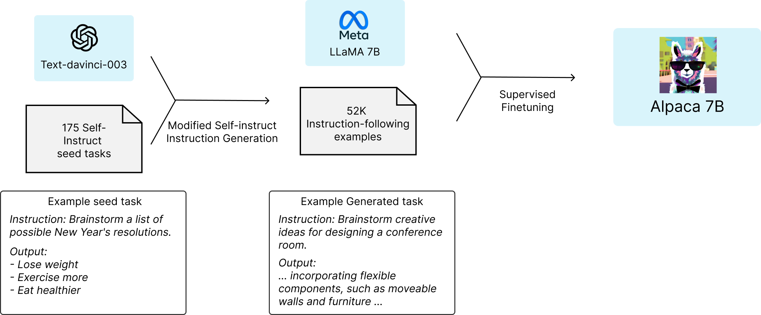
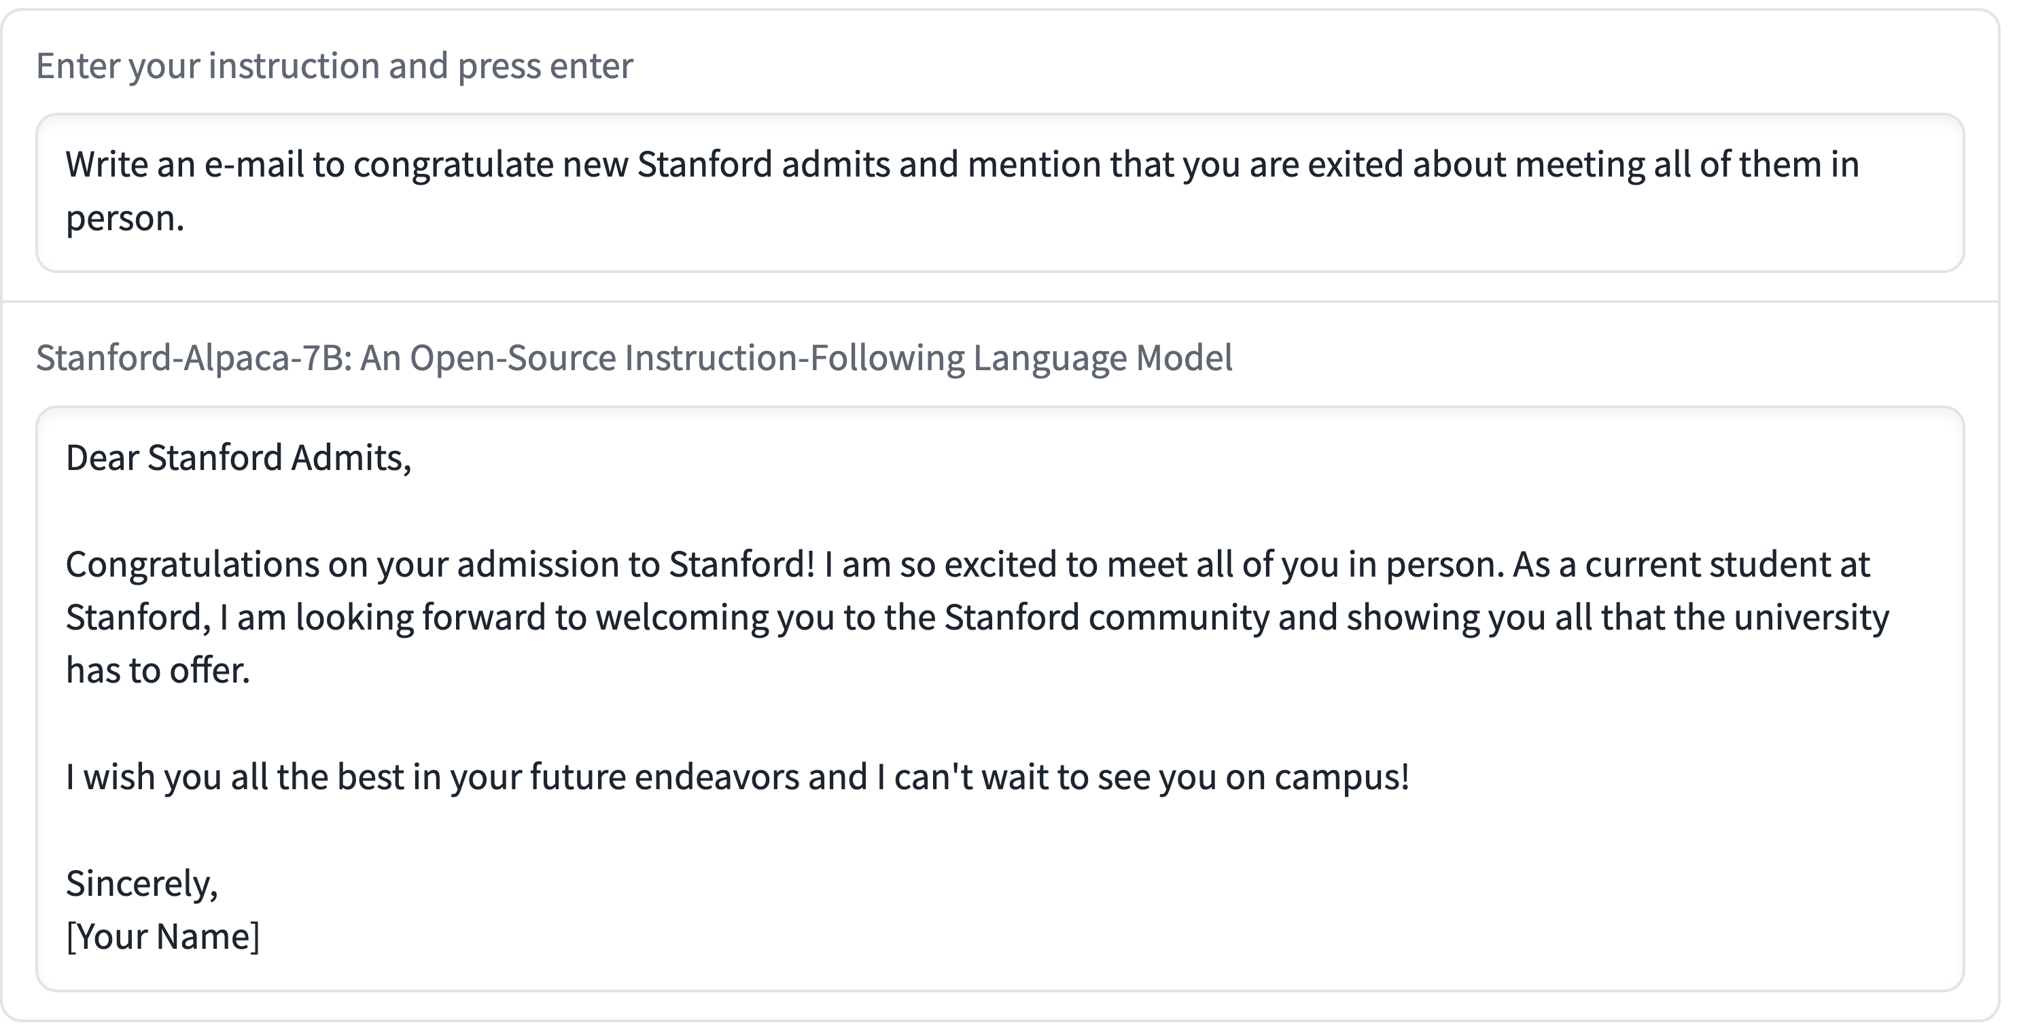
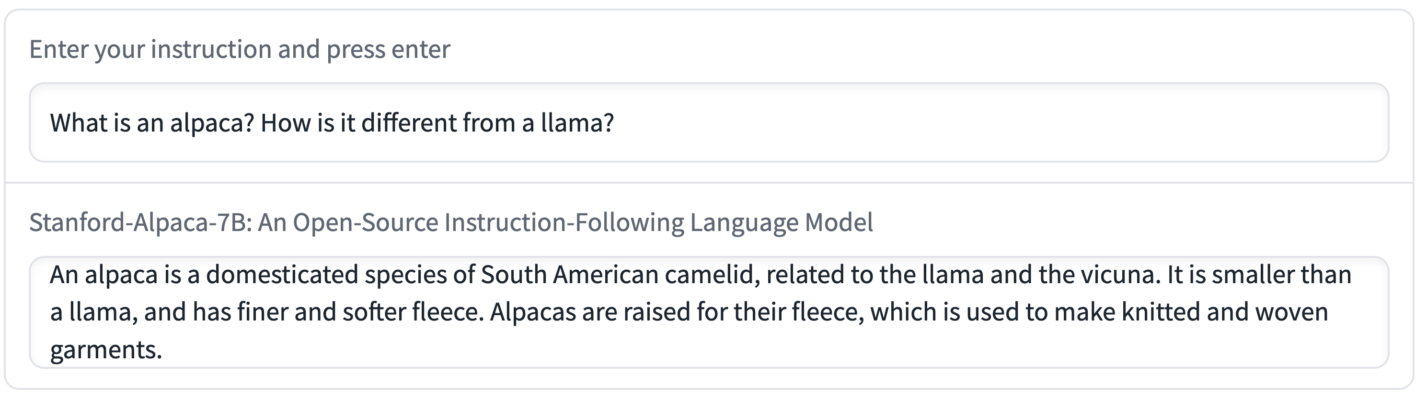
The first half – supervised data for instruction following.
Instruction following data, from $25k to $500
Captures many qualitative behaviors

Slide 17
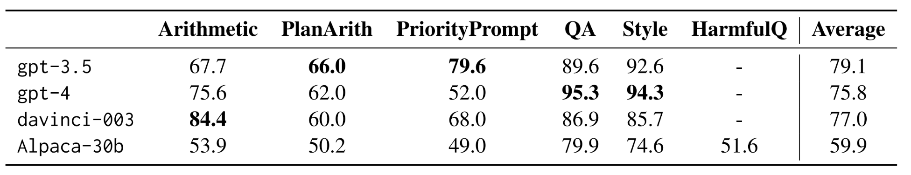
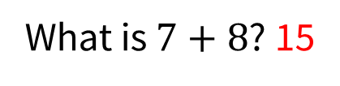
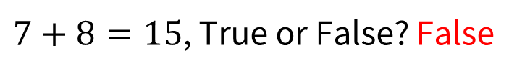
Limitation 1: Language models are inconsistent
For ChatGPT (3.5):
What is $7+8$? 15
But also..
$7+8=15$, True or False? False

Slide 18
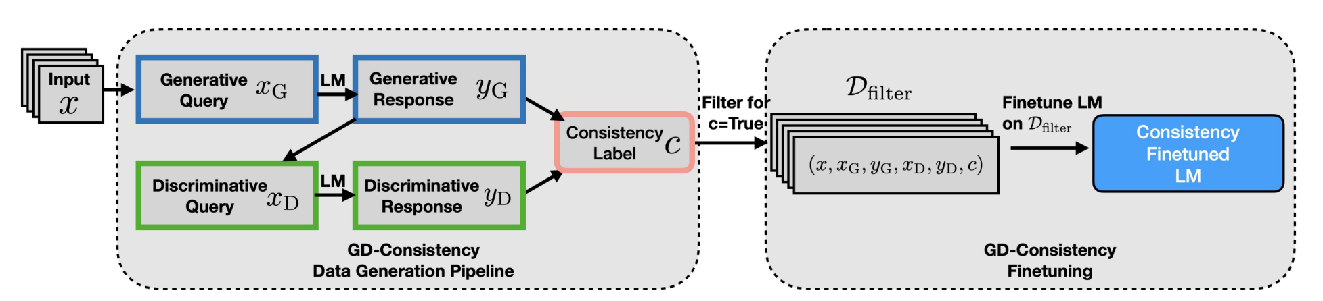
Can GD consistency be improved?
Our approach: filter and fine-tune
Inspired by co-training and self-training
Requires no labeled data
Straightforward to run on open models (Alpaca 30B)

Slide 19
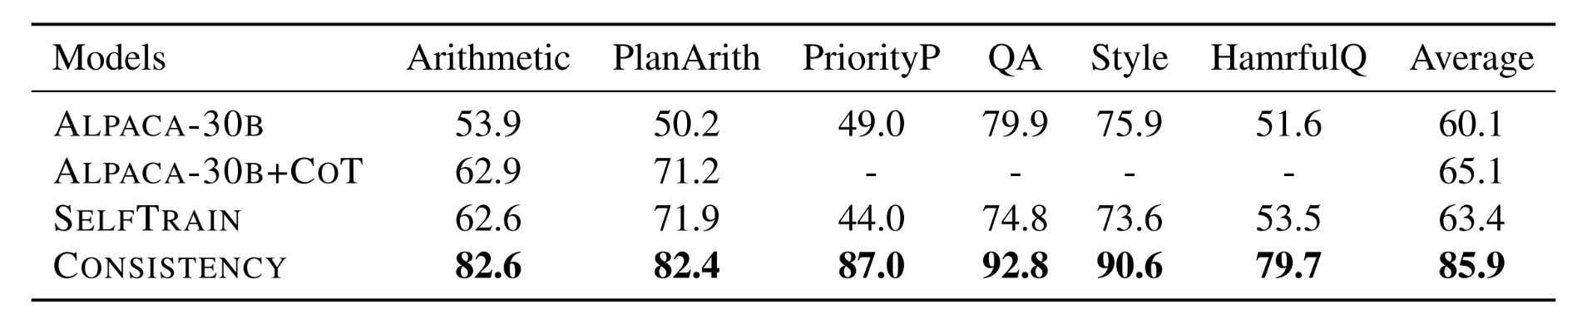
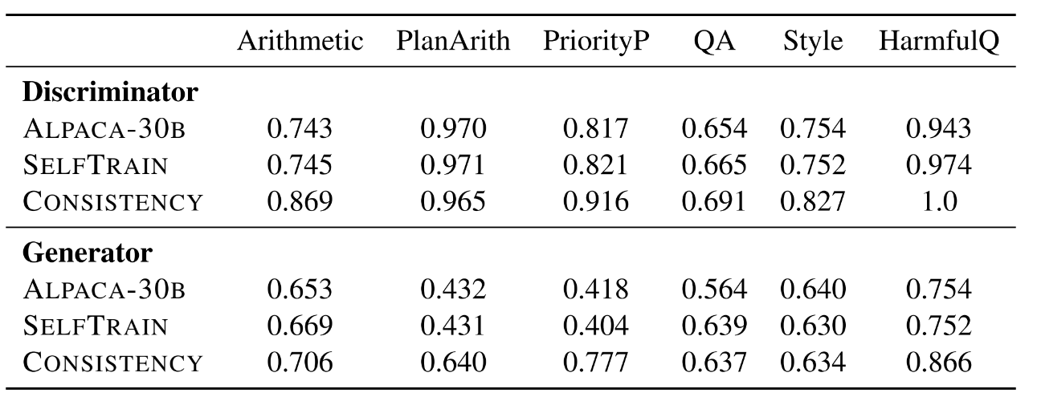
Results - consistency
Consistency tuning can improve GD-consistency substantially
Generator: major gains on 3 tasks (priority, plan arith, harmful)
Discriminator: small, but consistent gains.

